Slide 1
INSURANCE CONSULTANT
BY
SANDHYA GOSWAMI
SATHWIK KALLURI

Slide 2
PROBLEM STATEMENT
Insurance consultant is a Java application which integrates the requests coming from Various Insurance providers and assist the Customer who are looking for the best Product available.
It might be a herculean task for any individual who would like to be insured had to go through all the public and private Insurer’s available individually who provide them required services and then choose amongst them. Few cases, a customer needs multiple types of insurance and he would have to go through a long lasting process to complete the entire process to get insured.
Despite all this effort, sometimes the customer may find himself ending up with a mediocre policy/product as later they find out that there are even better plans .
Even the Insurance companies sometimes in process of finding customers end up in offering less services to the customers than promised which makes the customers dissatisfied.

Slide 3
APPROACH:-
To Overcome this problem, We created an application where we integrate all the Insurance providers on to a single platform that allows customer to choose the best available product given any kind of insurance required like life insurance,health Insurance,Vehicle Insurance,property Insurance,etc..
The application also helps insured individual during claims and renewal times. . Even the Insurance companies could reduce their hassle of approaching the customers to get insured, Verifying the background, and concentrate more on providing effective assistance to the insured by reaching the claim expectations.
We have Health Regulatory enterprise which regulates insurance policies proposed by the insurance companies and approve/reject it accordingly, then the policy is made available to the customer through the insurance consultant platform, then the customer can choose among the available policies and get insured with required policy.

Slide 4
The Application consists of 4 enterprises as per the eco system model:-
The Insurance Regulatory, which approves a policy proposed by a insurance company and also monitors the insurance companies, It has 3 Organizations underneath it
a) Regulatory Management b) Life Insurance regulatory
c) Health Insurance regulatory d) Vehicle Insurance regulatory.
The Insurance company , Which proposes an insurance policy and forward it to the regulatory for approval and make it available to customer through insurance consultant if approved ,
It has 2 organizations underneath it:
a)Business Management . b) Product Management.
3. The Insurance Consultant ,which acts as a bridge between insurance companies and customers. It receives the list of policies from insurance companies and make them available to the customers and when customers intends to buy a policy or raise a claim process them. It has 4 organizations underneath it:
a) Customer service organization. b)Document Verification or Under Writer org. c) Billing Org.
d Claims org.
4. The Hospital Enterprise, where when a customer with a policy visits after billing based on policy of customer, it raises a claim related to customer from the Insurance consultant claims department. It has one org underneath it:
a)Hospitalpayment

Slide 5
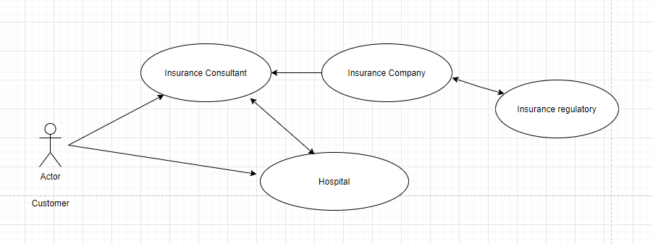

Slide 6
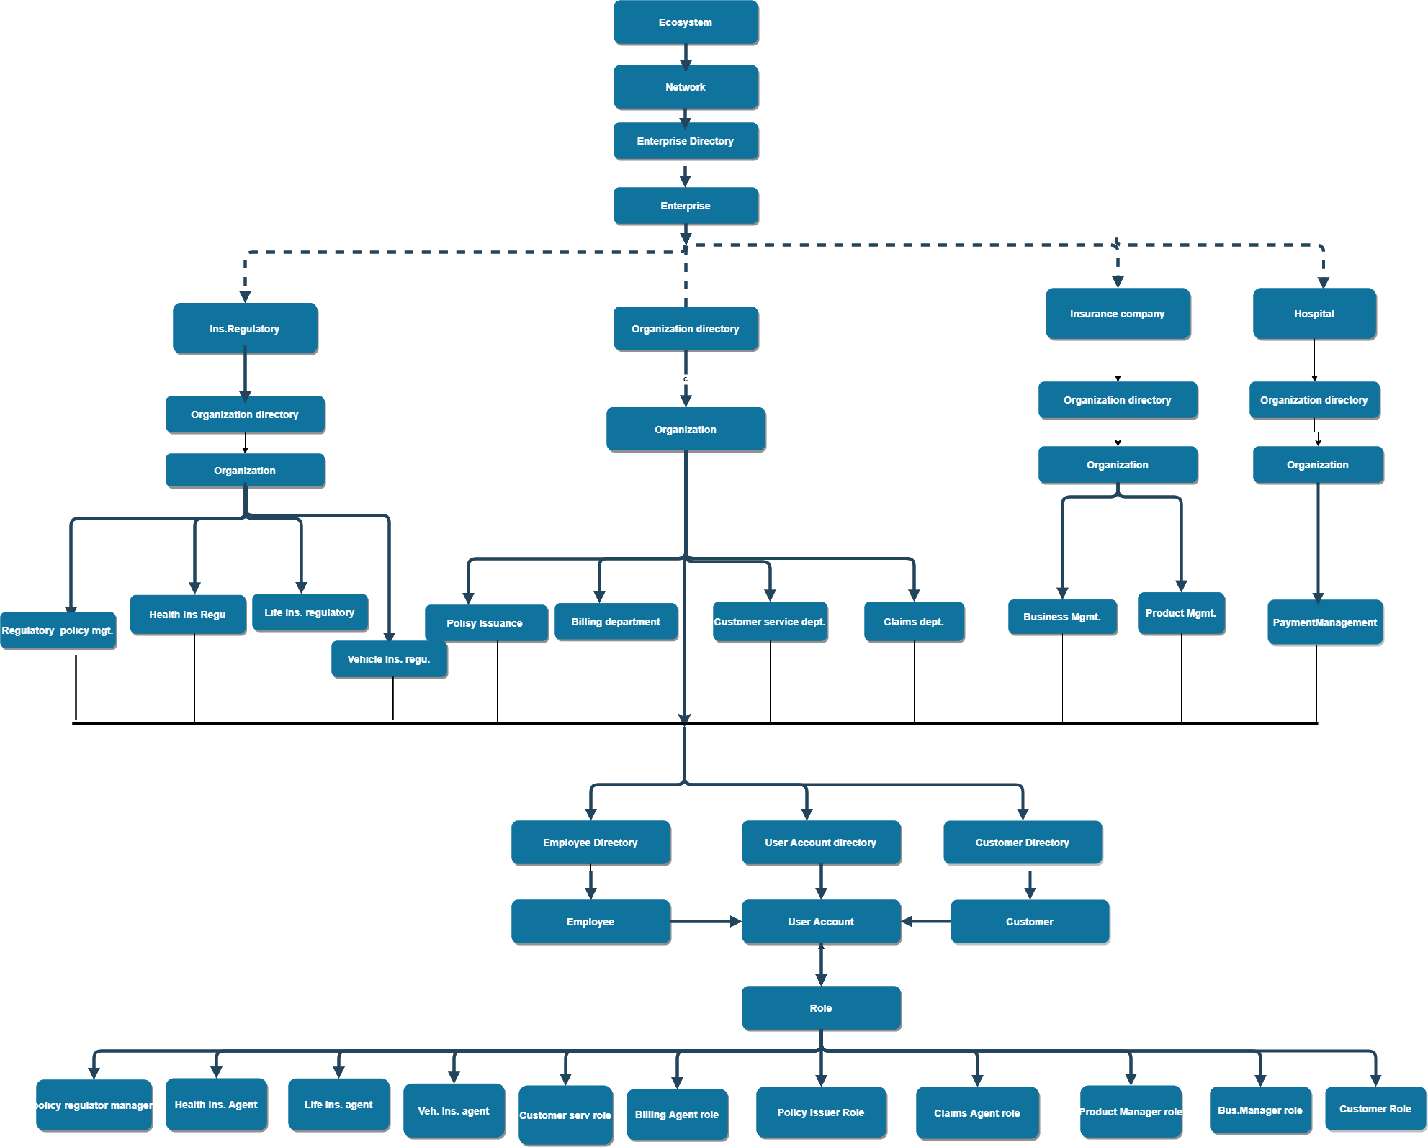
ECOSYSTEM

Slide 7
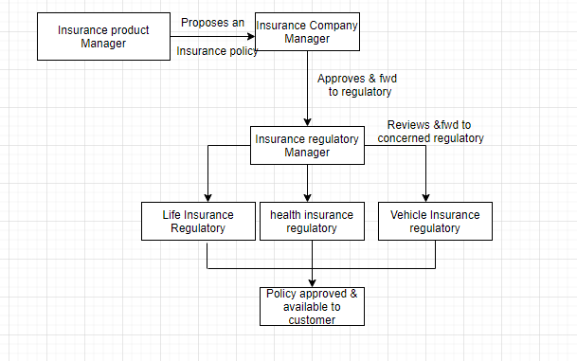
The Work Flow in the application is as follows:
.
Initially A Product Manager from insurance company enterprise proposes a policy and then the moves forward to business manager for approval , Then the manager process the request to the Insurance regulatory enterprise to get it approved.
Once the policy is reached to the Insurance regulatory it is initially received by Regulatory Manager, then based on the type of insurance policy proposed ( life or Health or Vehicle) It is then forwarded to the concerned regulatory and then the policy is available to the customer if approved.

Slide 8
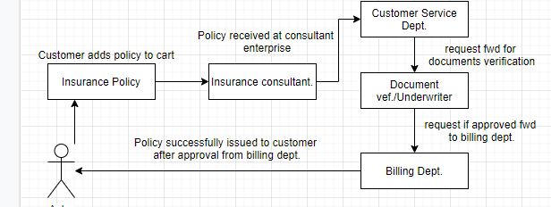
2.
The second Request is from customer once chooses the policy and adds it, it is received by the Insurance consultant enterprise where it initially reaches to customer service agent, it is then forwarded to Underwriter/Doc. Verification agent, once It is approved at doc. Verification it is then forwarded to billing department for final approval.
Once it is approved by billing organization the policy is successfully issued to customer.

Slide 9
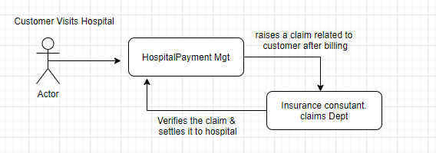
3.The Third Work request Is between the Hospital enterprise and the Insurance consultant enterprise,Whenever a customer visits the hospital after billing the hospital raises a claim request related to policy of customer to the claims department of the Insurance consultant enterprise ,there it is approved/rejected based on verification done.

Slide 10
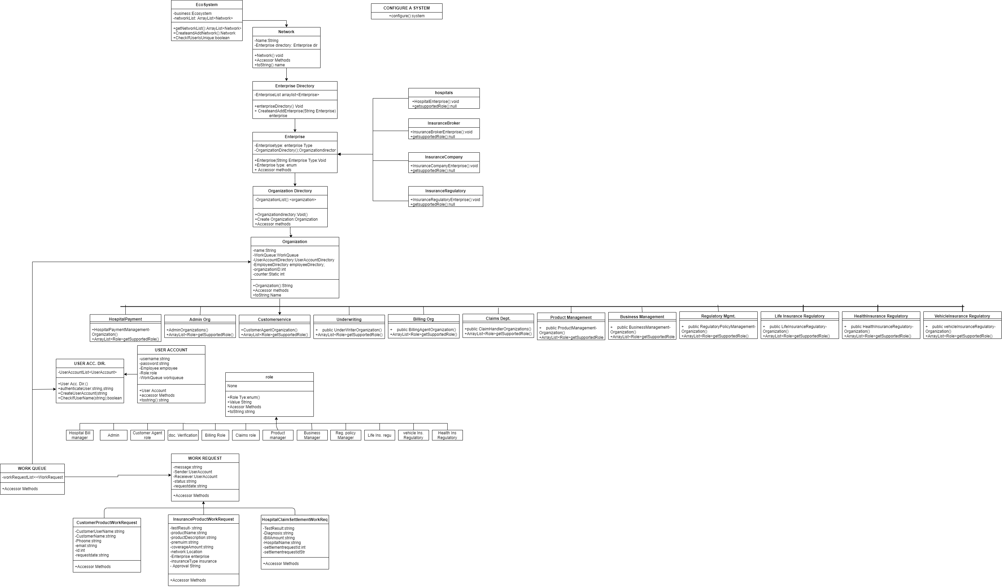
OBJECT MODEL

